Slide 1
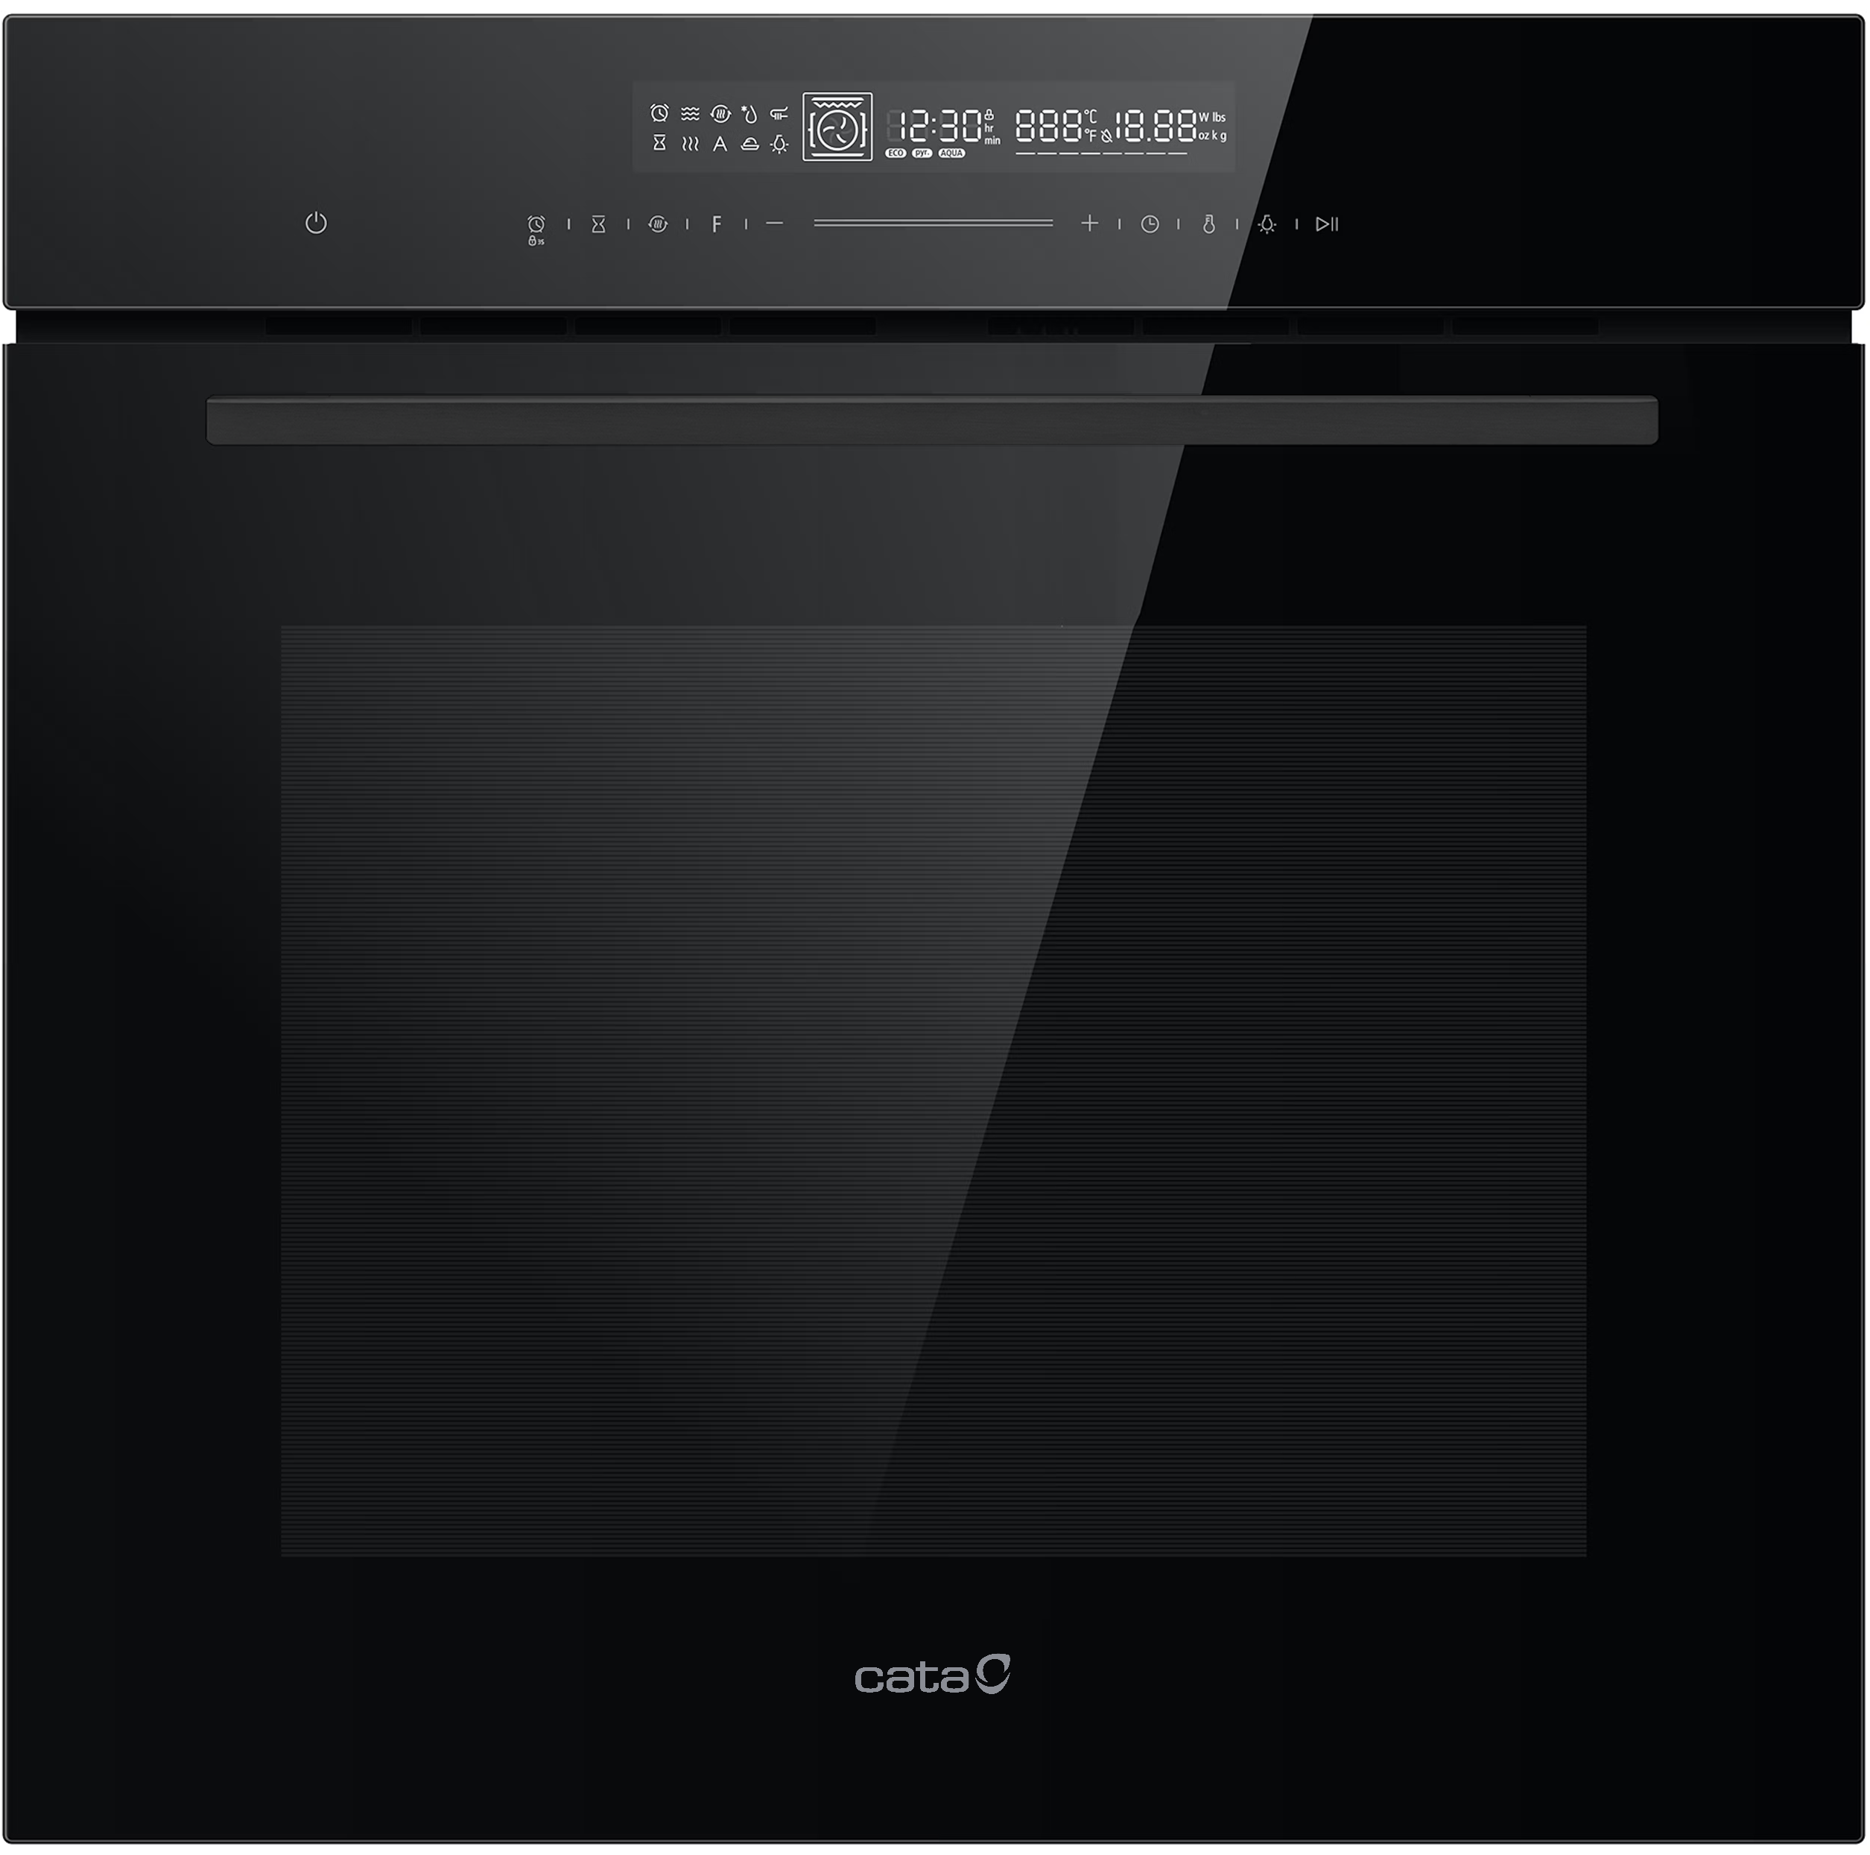















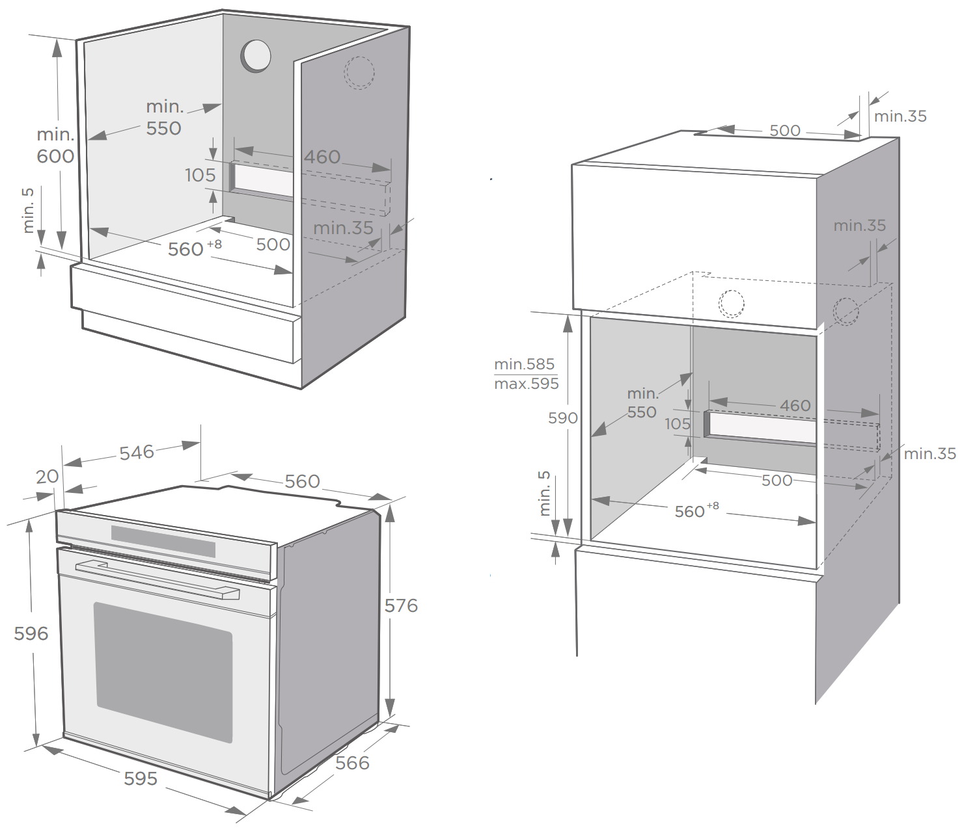
CAT72PYBK
60CM BUILT-IN PYRO OVEN
Main Features
Brand | Cata
Oven | Multifunction Pyro
Heat Source | Electric
Colour / Finish | Black
Capacity (net) | 72L
No. of Functions | 14
User Controls | Full Touch with LED Display
Characteristics
Oven Type | True Fan with Grill
Door Colour | Black Glass
Door Handle | Black Aluminium
Control Panel | Black Glass
Display Colour | White
Clock Timer | Full Programmer
Oven Cavity Finish | Easy Clean Blue/White Enamel
Oven Cleaning | Pyrolytic
Shelf Positions | 5
Oven Lights | 2
Cooking Modes | Defrost, Rapid Pre-heat, Pizza, Sabbath, Pause, Fermentation
Door Opening | Drop Down
No. of Door Layers | Quadruple Glazed
Soft Close | -
Safety | Child-Lock, Cooling Fan, Safety Shutoff, Auto Door Lock
EAN
8422248617840
Supplied Accessories
Shelf Racks | Chrome Rails
Oven Shelves | 1
Oven Liners | -
Telescopic Rail Set | 1x 100% Extension
Oven Tray | Yes, Deep
Grill Trivet | Yes
Technical Data
Rated Voltage | 220-240V ~ 50/60Hz
Max Power | 3200W
Supply Connection | 16A
Cable / Plug | 1.5m / -
Energy Efficiency Class | A+
Energy consumption, conventional | 1.06 kWh/cycle
Energy consumption, fan-forced | 0.69 kWh/cycle
Dimensions & Weights
Product (WxHxD) | 595 x 596 x 566 mm
Built-In Niche (WxHxD) | 560 x 590 x 550 mm
Packed Product (WxHxD) | 720 x 670 x 650 mm
Net Weight | 40.0 kg
Gross Weight | 44.0 kg

